Slide 2
Advanced design training
Leverage visual and coding tools to design

Slide 3
Use the links - do not lose your way!
Coders
Internal API
Code env
Folders
Static insights
Python R notebooks
All
prep data
Flow views and actions
Windows
Top N
Clickers
code for clickers
plug in recipe
Coders
Make your own plugin
Dynamic SQL query
Optional
Optional
Optional
All
SQL notebooks
variables
More coding capabilities
Text visual ML
Geo clustering
Notes:
If you lose your way, please refer to this slides

Slide 4

Advanced Design Training
Remember the West Niles Virus from the discovery training ?
⇒ We designed a pipeline to ingest, clean and visualize data. We also created a model that can be used to forecast West Nile virus presence at different locations in Chicago
In this training
We analyze the public perception of the Virus across the US
Specifically, we will analyze tweets that mentioned the West Nile Virus from years 2007 to 2017
We use and develop various code based features and/or advanced visual features to design a flow

Slide 5

Coder track
This training covers the following coding features
Interacting with datasets using Python or R
Working with Jupyter / SQL notebooks
Creating code environment
Creating visual extension to DSS: plugins
Overview of the different APIs in DSS
Working with folders, variables and much more!
But also some visual features
The window recipe (sliding aggregations)
Mass flow actions
and more!

Slide 6
Clicker track
This training covers the following visual features
Prepare and enrich your data
Mass flow views and actions
Visual interface custom code based (plugin)
Window recipe (sliding aggregations)
But also some more advanced features
SQL notebooks
Working with instance variables
Working with folders
Visual ML with text data
Geo clustering
and much more!

Slide 7
Discover and prepare the data
Hands on

Slide 8
Tweet data
The data
In this section we
Import the tweet data and look at the data
Investigate and clean the text
Use a regex to extract mentioned users Aims: find influencers, build a community graph, …
Find tweets containing “bite”
Remove very short tweets
Simplify and normalize text Aims: make the text usable for further use like finding insights and creating usable data for machine learning

Slide 9
Connecting to your instances
Access to DSS training instances
https://dssX-design-YOUR_COMPANY.hadoop.training.dataiku.com
X = 0, 1, ...
user: userY, Y = 0, 1, ...
password: to be given by the trainer

Slide 10
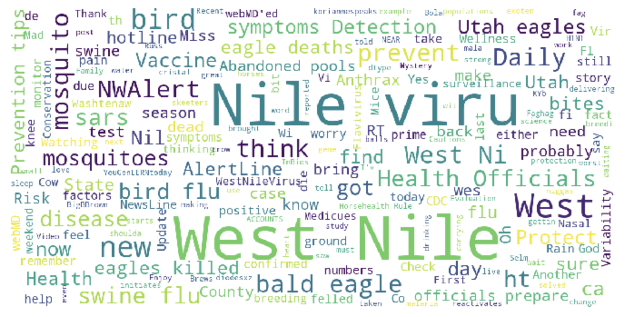
Tweet data
The data
Tweets that mentions to the West Nile Virus from 2007 to 2017!
TO DO: Create a new project and name it Westnile_tweets_[yourname]

Slide 11

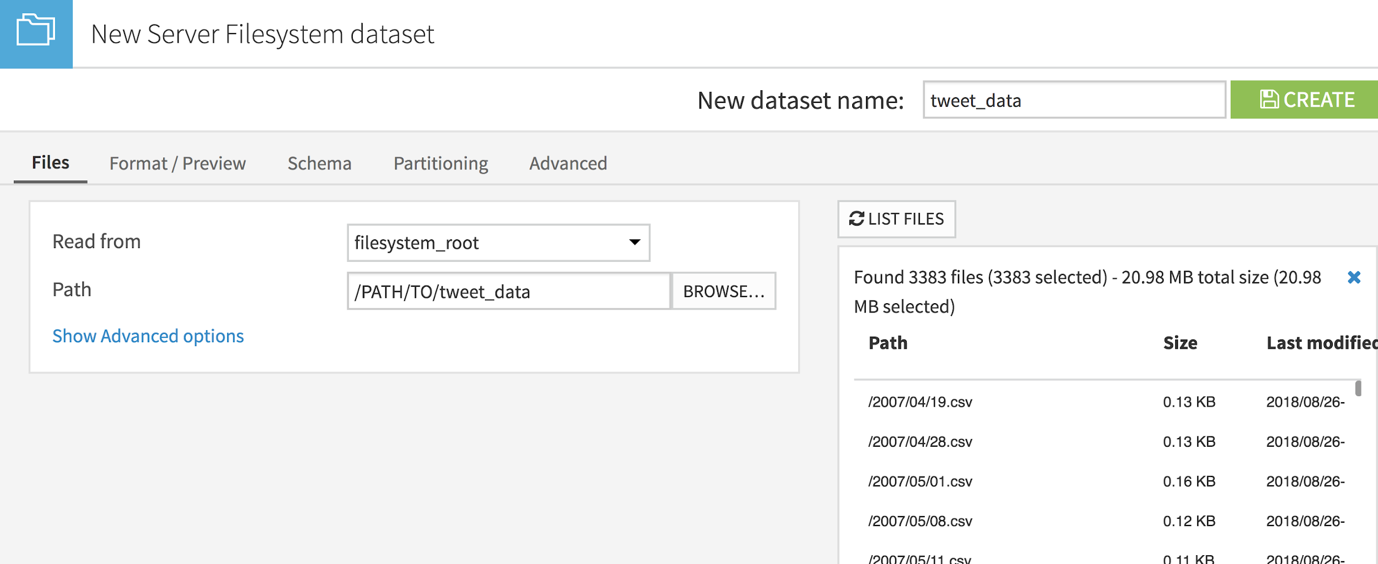
Tweet data
Importing the data
TO DO:
Import the tweet_data from file systems from data/shared/tweet
List the files. We can think to an external process that writes a new file every day
Name the dataset and create it

Slide 12
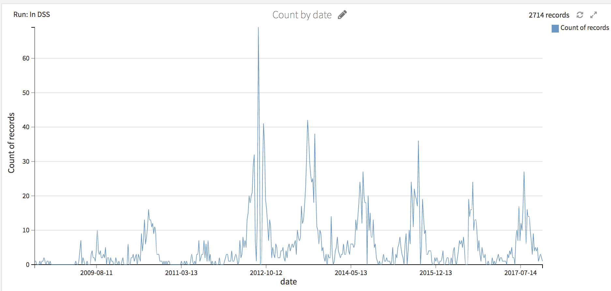
Tweet data
A first insight
TO DO:
Plot a first insight: number of tweets per week ⇒ change the sample if needed!

Slide 13
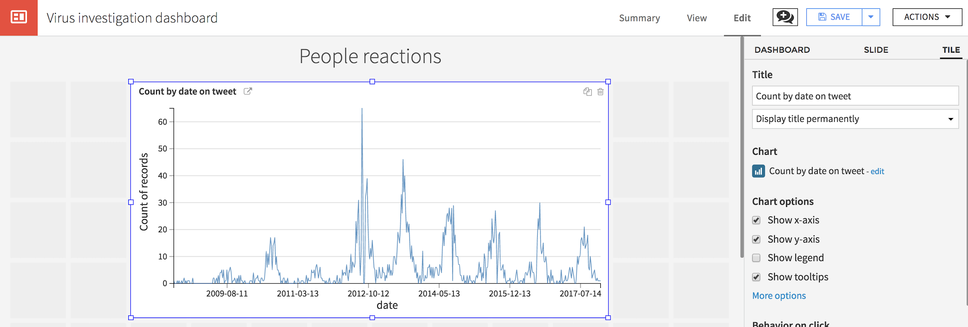
Tweet data
A first insight
TO DO:
Create a dashboard and export the chart
To display the title, go to the slide tab

Slide 14

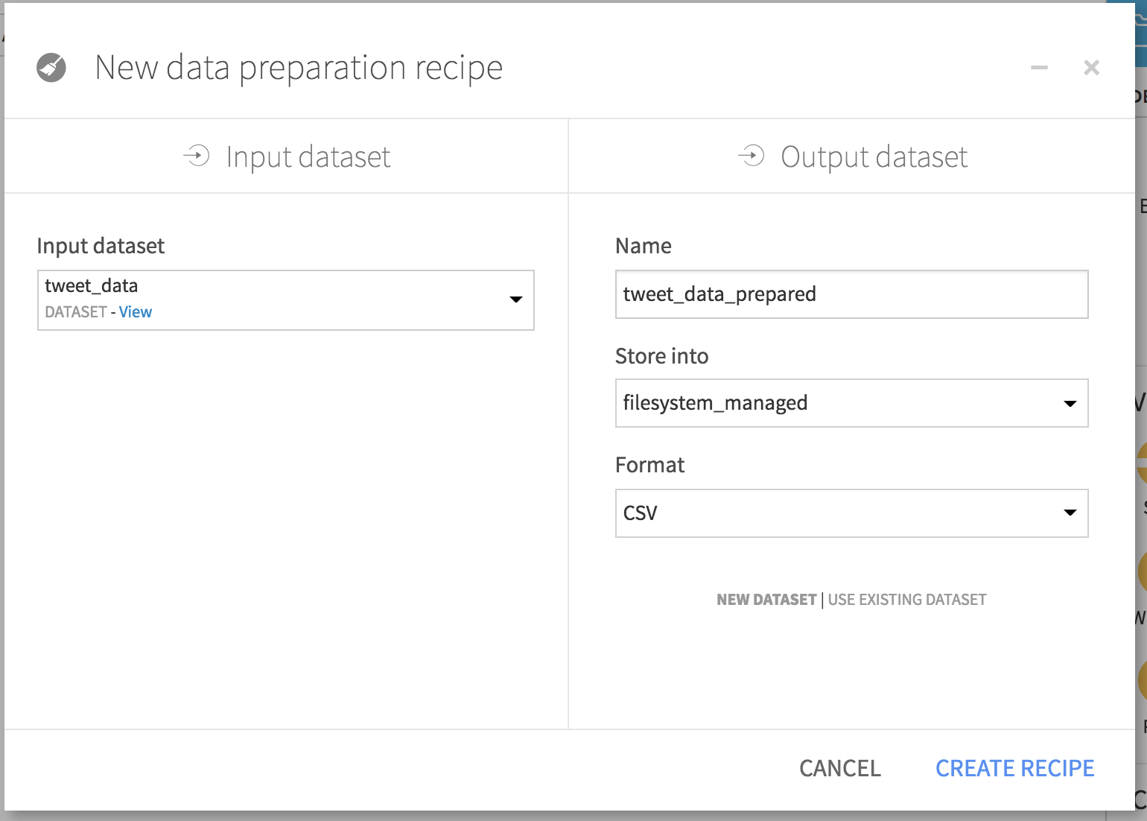
Tweet data
Prepare the data
TO DO:
Create a prepare recipe from the tweet_data dataset.
Store the output as a filesystem (CSV) dataset named tweet_data_prepared

Slide 15
Tweet data
Prepare the data
TO DO:
In the prepare recipe, add a new step that to extract with regular expression all the mentions @user Do not run the recipe yet
A regular expression, or regex, is a sequence of characters that defines a search pattern.
ex:
img_(\w+).* extracts from img_cat.png the word “cat”

Slide 16
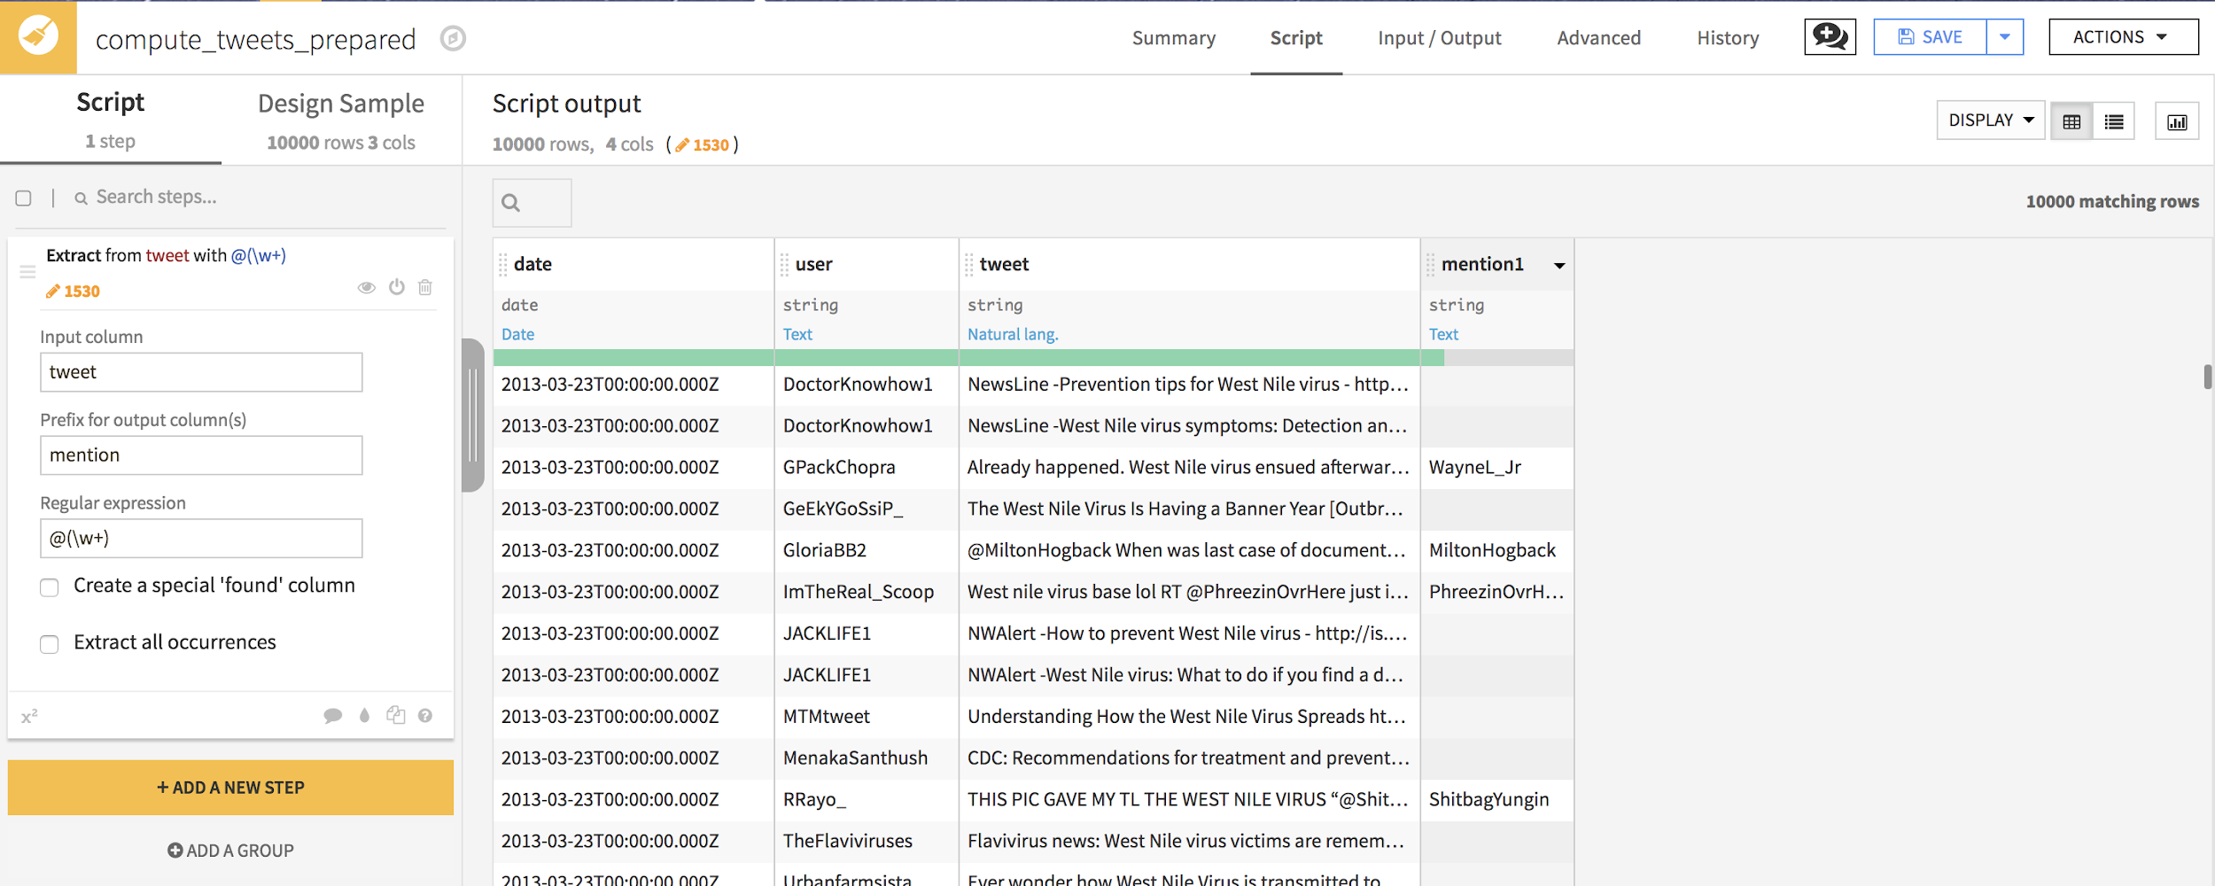
Tweet data
Prepare the data
TO DO:
Extract with regular expression all the mentions @user @(\w+) Do not run the recipe yet

Slide 17
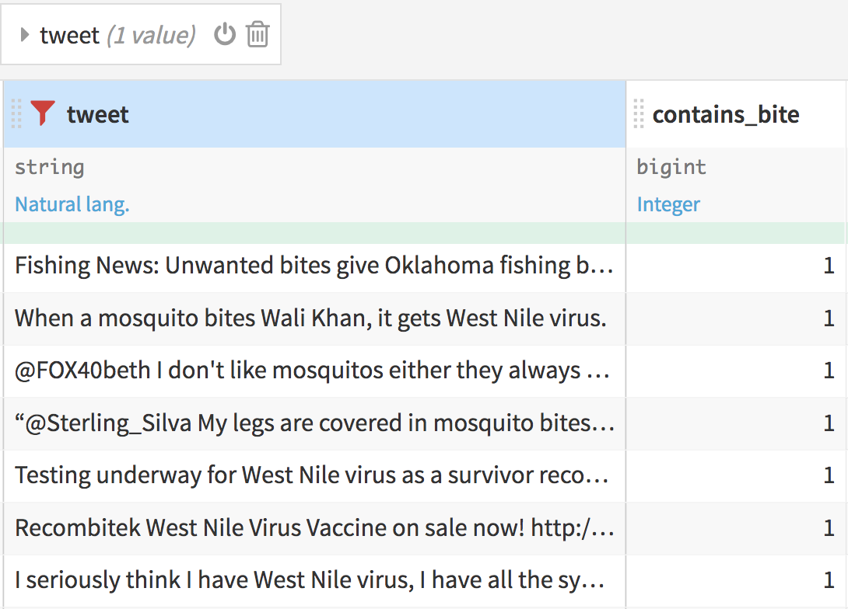
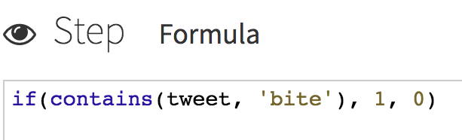
Tweet data
Prepare the data
TO DO:
Create a column to flag if tweet contains “bite” → use a formula with
if
contains
Take a look at the reference !
Check it worked by filtering on the tweet column

Slide 18
Tweet data
Text preparation concepts
CONCEPT
To get insights from text or use machine learning models, it is important not to work with raw text data
Normalize text:
Café → cafe
Stem words:
drinking, friendship → drinking, friendship → drink, friend
Clear stop words:
I drink a cup of coffee → I drink a cup of coffee → drink cup coffee

Slide 19
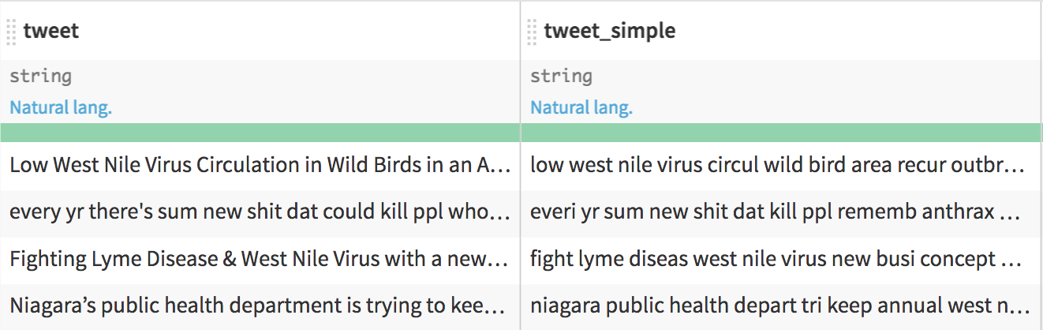
Tweet data
Text preparation concepts
TO DO: Simplify text:
Normalize
Stem words
Clear stop words
Do not run the recipe yet

Slide 20
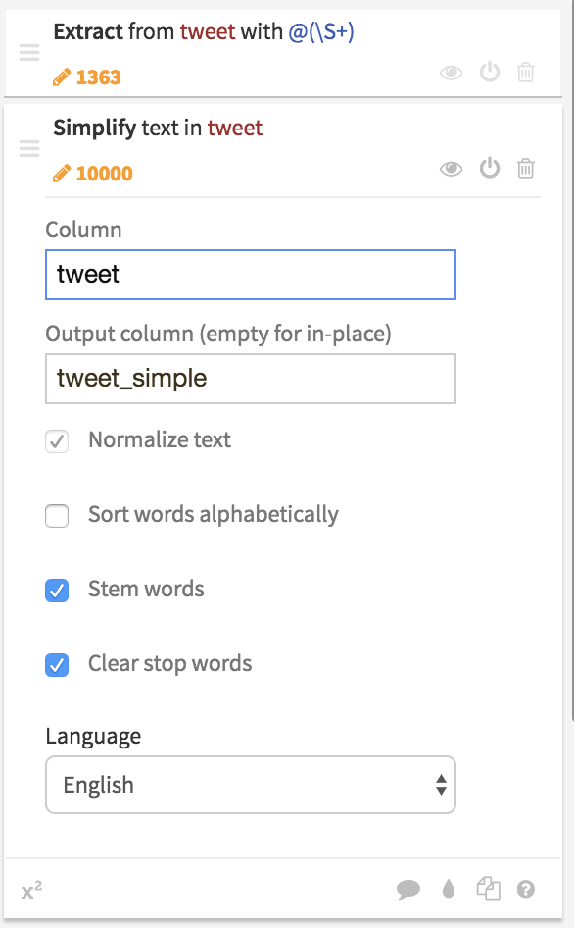
Tweet data
Text preparation concepts
TO DO: Simplify text:
Normalize
Stem words
Clear stop words
Do not run the recipe yet

Slide 21
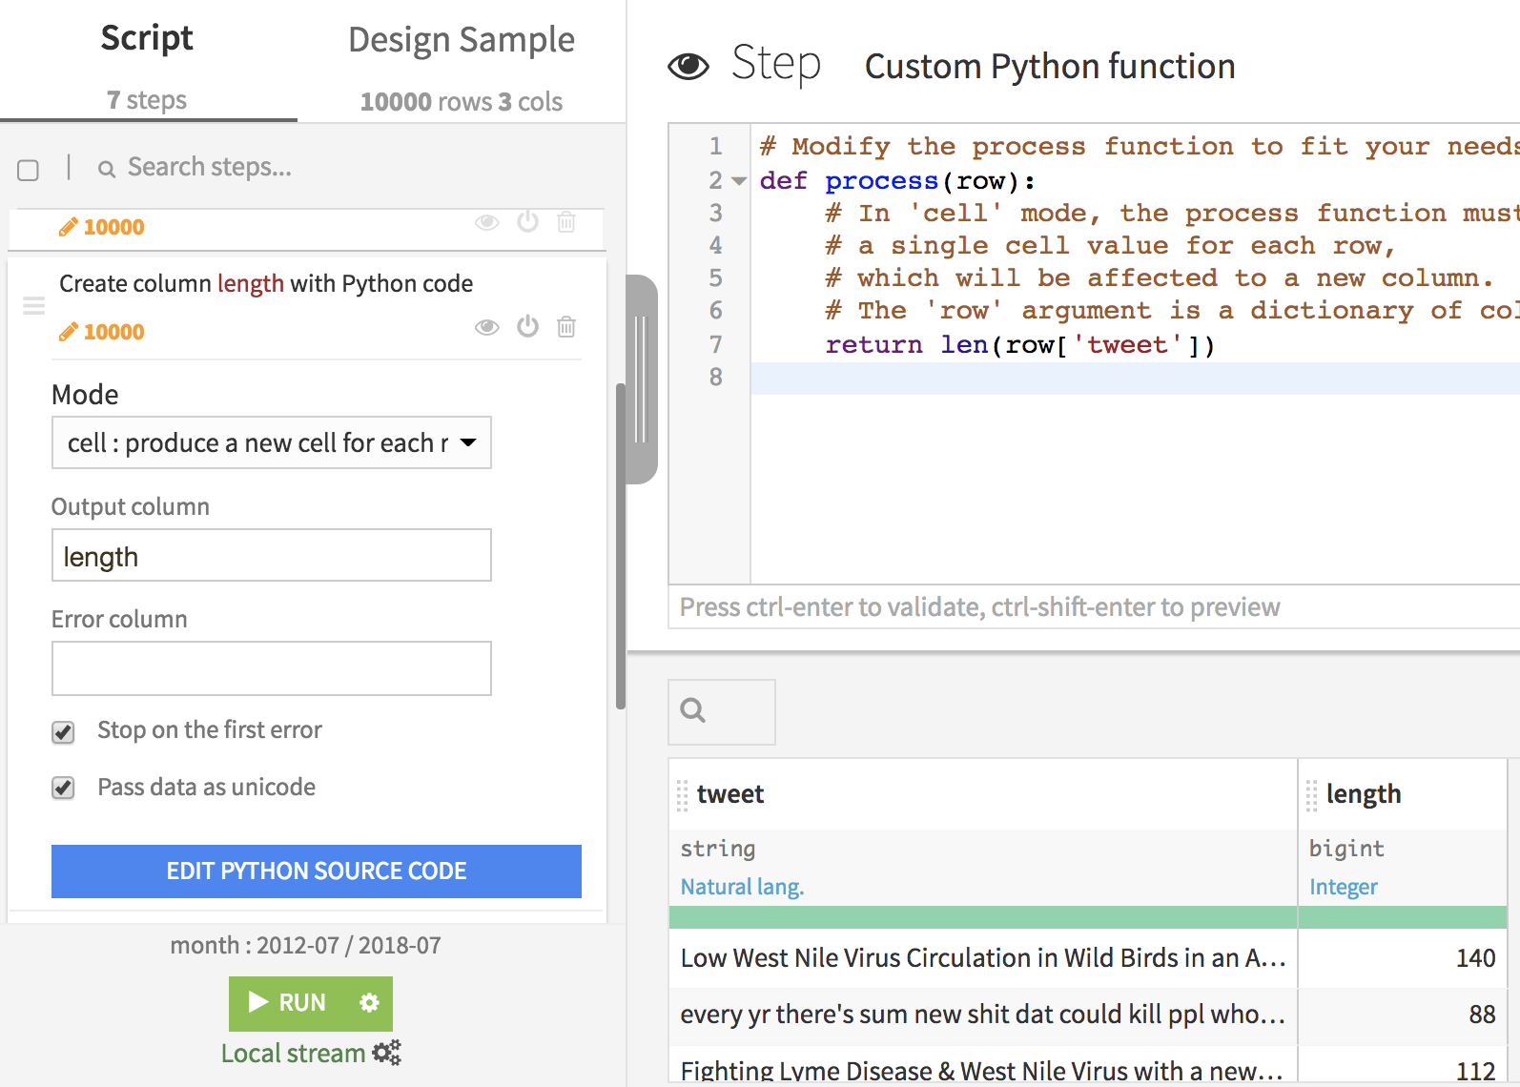
Tweet data
Text preparation concepts
TO DO: Compute length of tweets
If you are a clicker, use a formula
If you are a coder, use a custom Python code processor Beware: if you run the prepare recipe on a cluster, the python code cannot be translated into a Spark job!

Slide 22
Tweet data
Text preparation concepts
TO DO: Compute length of tweets
If you are a clicker, use a formula
If you are a coder, use a custom Python code processor Beware: if you run the prepare recipe on a cluster, the Python code cannot be translated into a Spark job!

Slide 23
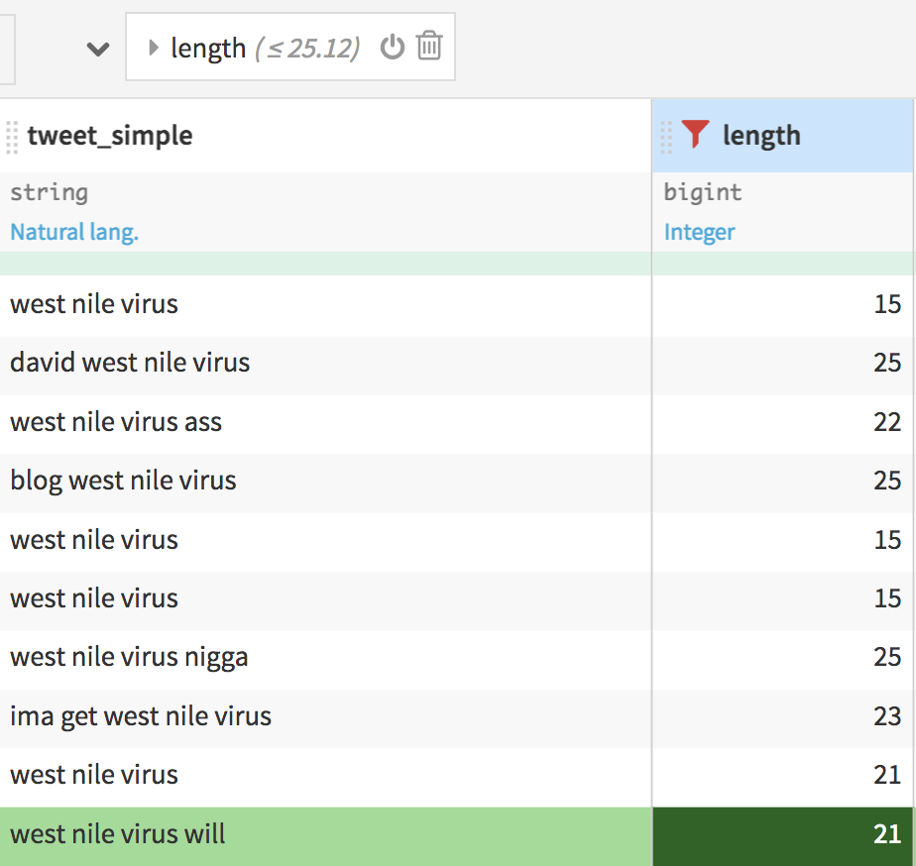
Tweet data
Filter short tweets
TO DO: Filter on the length column to show only rows where length < 25

Slide 24
Tweet data
Filter short tweets
TO DO: Filter on the length column to show only rows where length < 25
Those line are irrelevant, add a new step to remove them

Slide 25
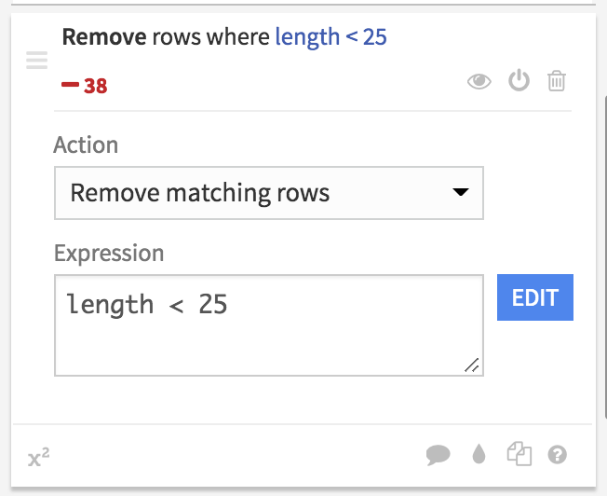
Tweet data
Filter short tweets
TO DO: Filter on the length column to show only rows where length < 25
Those line are irrelevant, add a new step to remove them

Slide 26

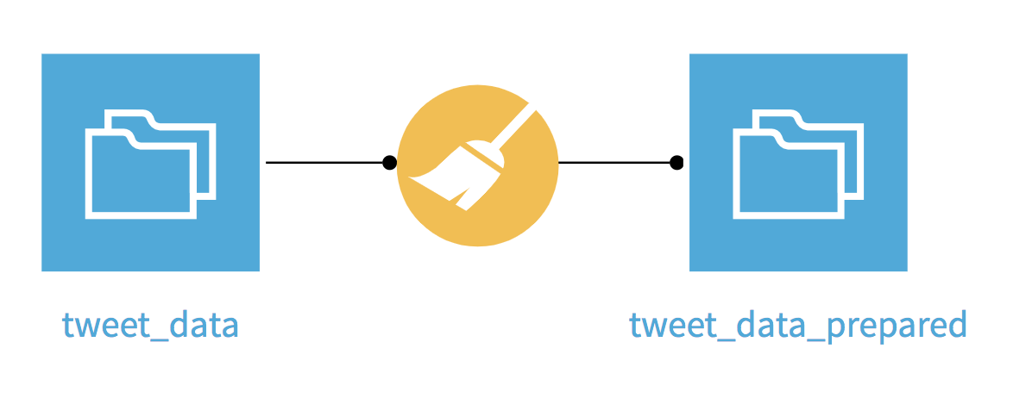
Tweet data
Run the recipe
The tweet data is now enriched and cleaned
TO DO
run the recipe

Slide 27
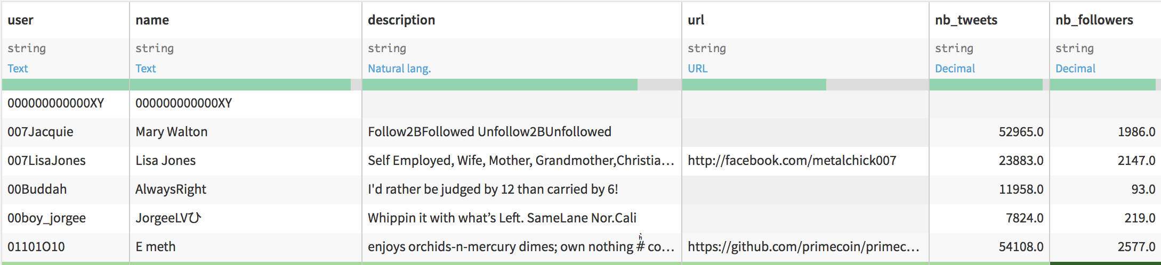
Tweet author data
Author info to enrich the tweet dataset
Let’s add some information about the author to our study.

Slide 28
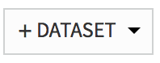
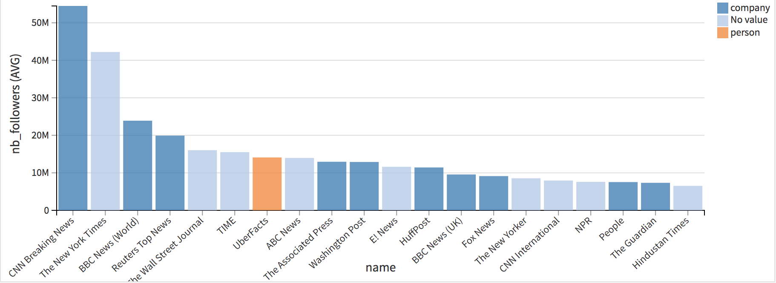
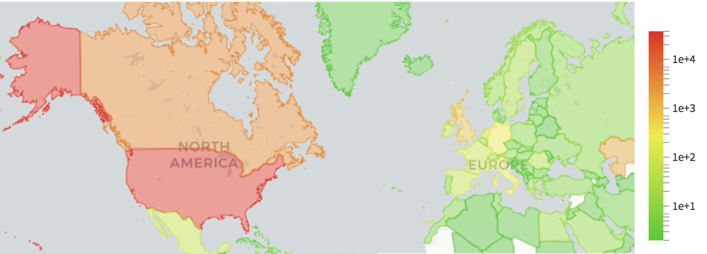
Tweet author data
Author info to enrich the tweet dataset
TO DO:
Create the author dataset from filesystem_root:/data/shared/author_data
Explore the data and build graphs showing
the total number of tweets per country (change the scale to better catch the distribution)
the name of authors with the biggest nb_followers values and the label: human or company
Publish the viz in the dashboard
See solution next slide !
Notes:
Remark that some author are not properly labelled: we estimated the label with human or company website.
Start of coding track

Slide 29
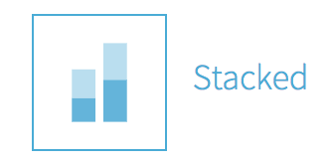
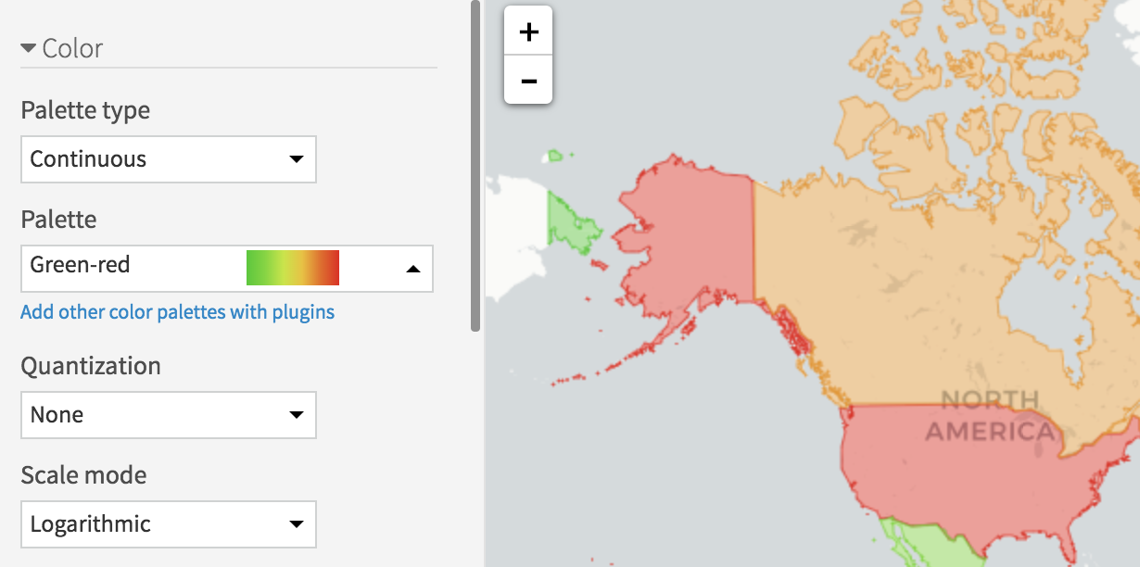
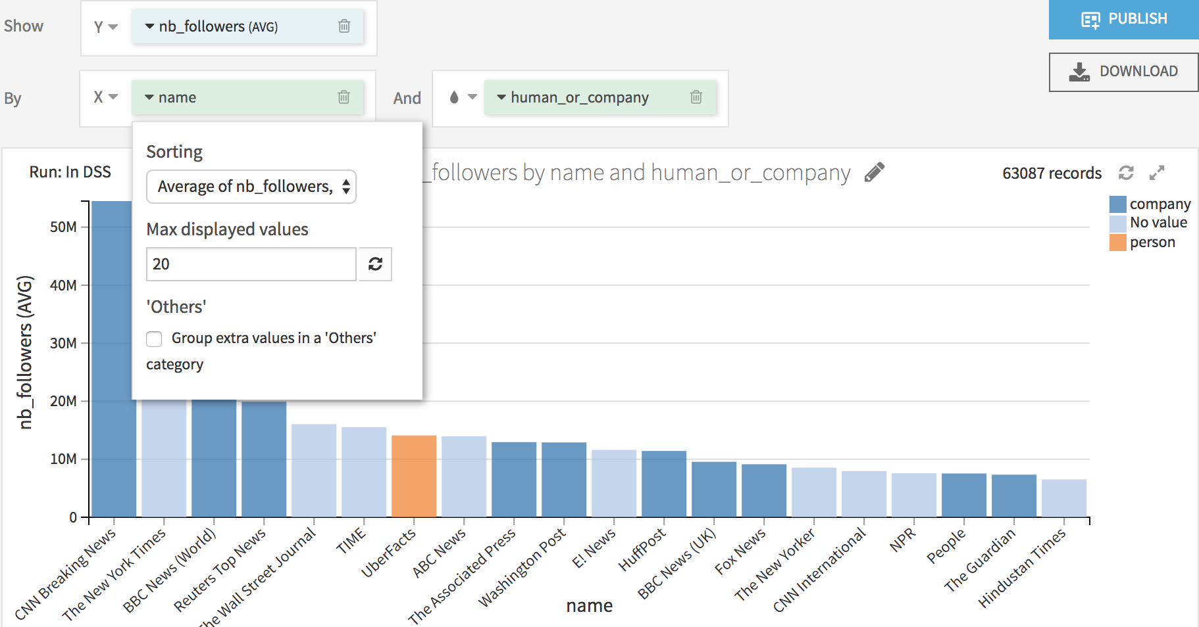
Tweet author data
Author info to enrich the tweet dataset
Notes:
Start of coding track

Slide 30

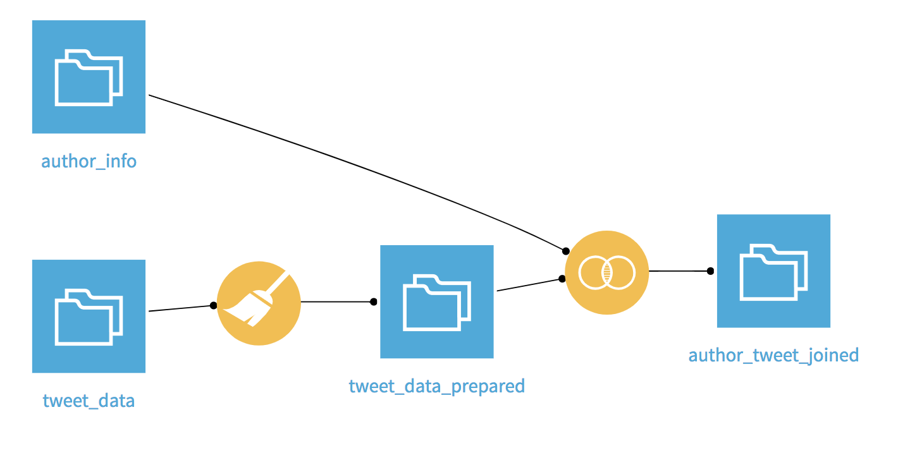
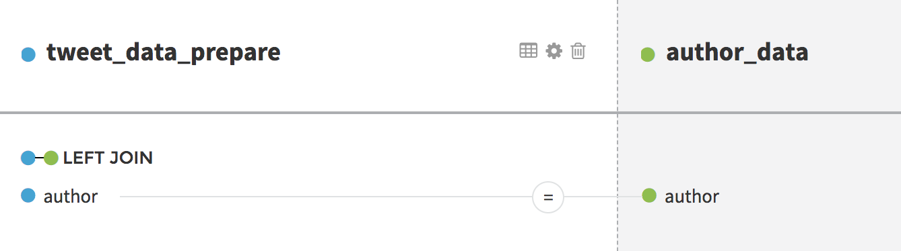
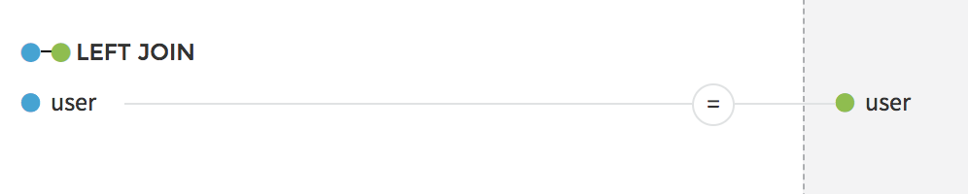
Tweet author data
Author info to enrich the tweet dataset
Now, we enrich the tweet dataset with information about the author of the tweet
TO DO:
Join the author and tweet datasets
Put the author name aside every tweet

Slide 31
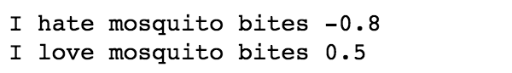
Coding in DSS
In the next slides, to investigate the sentiment of people reactions, we:
Create a column with the polarity of the tweet
Create a wordcloud from the tweets
WHAT’S NEXT ?
These features are not natively included in DSS, they have to be recoded
by you if you are a Python or R coder
by any coder from your team, then a visual interface will be available and you will be able use those features without seeing a single line of code!
Notes:
Start of coding track

Slide 32

What’s next ?
Coding in DSS
For coders go here
For clickers go here

Slide 33
Leveraging code for clickers

Slide 34
Collaboration
Coding and clicking
CONCEPT
DSS enables teams to collaborate through coding and/or clicking
There will still be times when you need features that are not natively available in DSS
Ex: Have recipe that uses Google Maps API to get driving distances from two address columns in a DSS dataset
DSS allows teams to code customized applications, to be utilized by nontechnical people with a visual interface
We name them Plugins.
Useful resources :
Official released plugins: http://www.dataiku.com/dss/plugins/
Dev doc: http://doc.dataiku.com/dss/latest/plugins/index.html
Plugin Tutorial: http://learn.dataiku.com/howto/code/plugins/writing-your-first-dss-plugin.html
Public Git Plugins : https://github.com/dataiku/dataiku-contrib

Slide 35
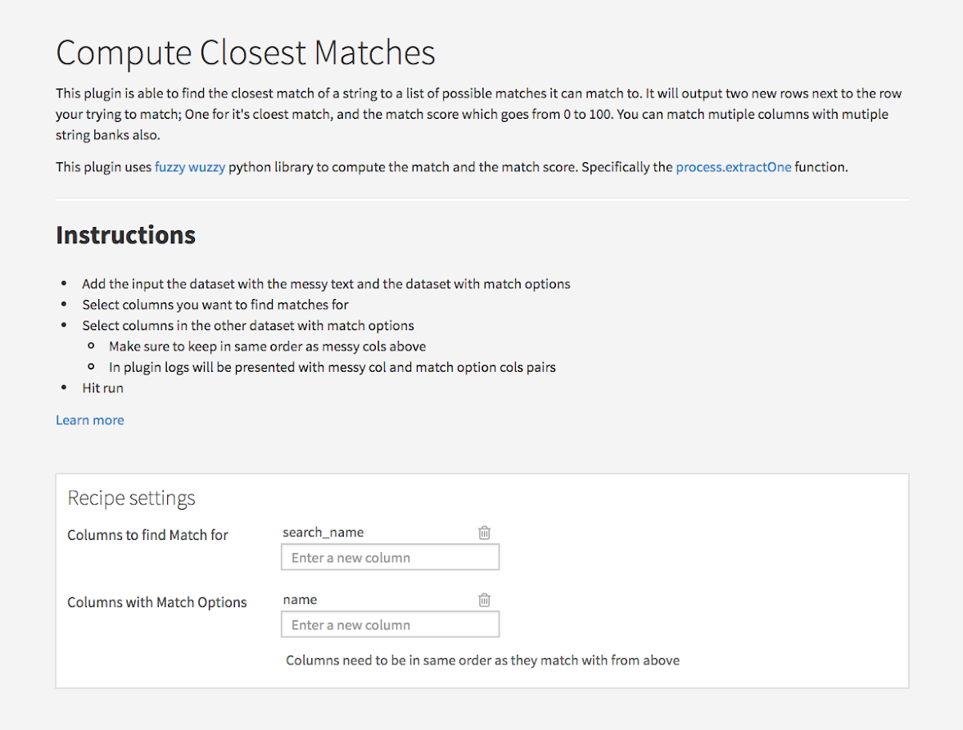
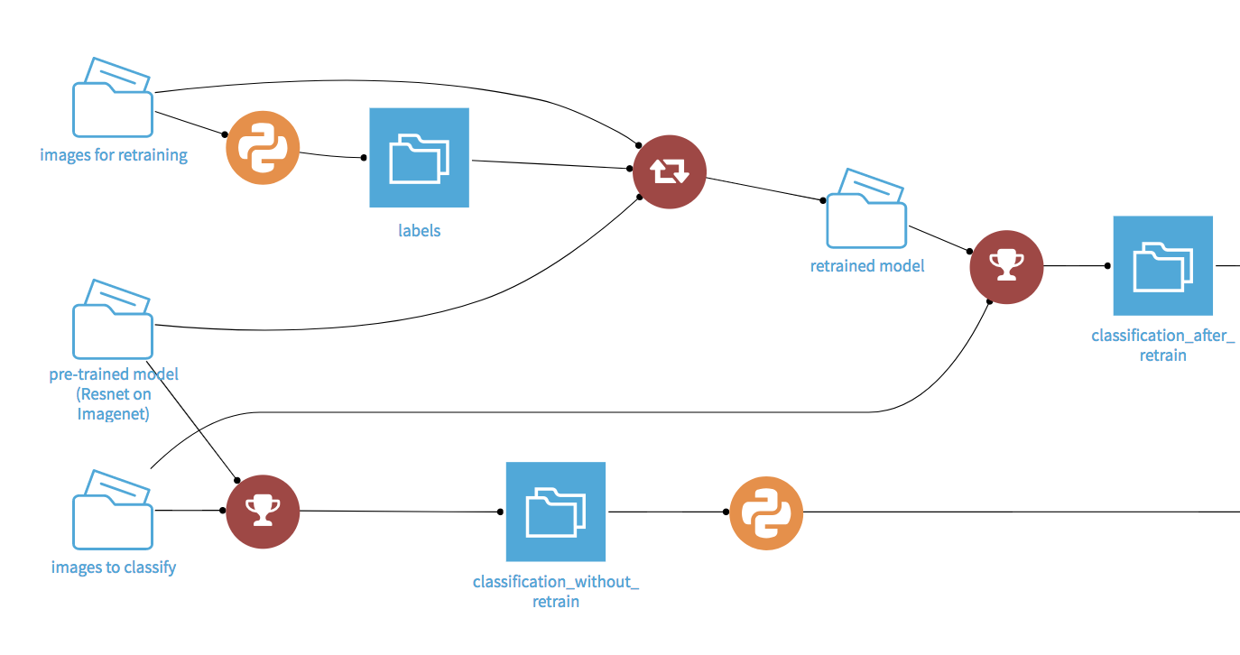
Personalized Data Science
Plugins
CONCEPT
Create new visual recipes with plugins
Contains UI for easily customizable parameters for plugin users
Allows Analyst and other Data Scientist to utilize your commonly used code snippets
Document with Markdown or HTML/CSS
Shows up as red circles in flow with changeable logos

Slide 36
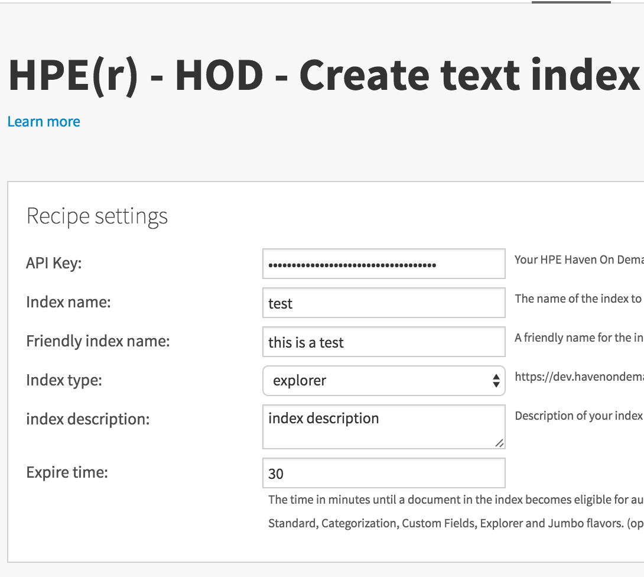
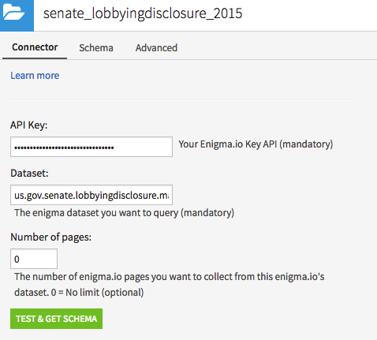
Plugins
Types of Plugins
CONCEPT
In DSS plugins, the user can develop :
Custom Recipes
A custom recipe is a basic user interface allowing the users to interact with variables of the underlying code: R, Python, SQL in Python
The recipe loads 1+ output dataset(s) without necessary an input.
Examples :
Query a rest API with some settings
Apply a statistical function to a field of dataset
Custom Dataset
A connector to a datasource.
Example : query a salesforce table.
Much More
New Preparation Step Processor
Custom Scenario Step
Dataset Exporter
Web App/R Markdown Template

Slide 37
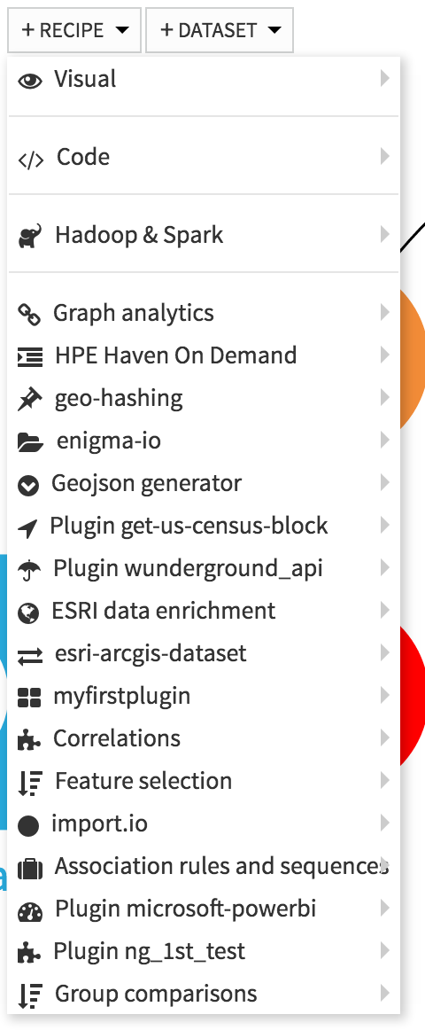
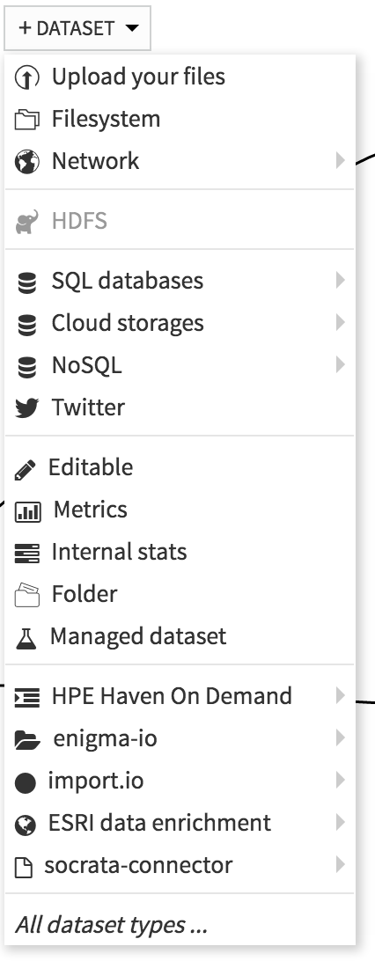

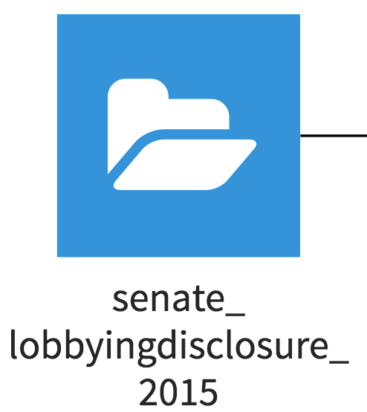
Plugins
Intro
CONCEPT
Plugins are then available as a DSS extension as a new recipe or a new dataset :
A plugin icon based on font awesome is defined by the developer. A recipe will be displayed in red in the flow
A custom dataset will be displayed in blue in the flow with the related plugin’s icon :

Slide 38
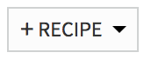
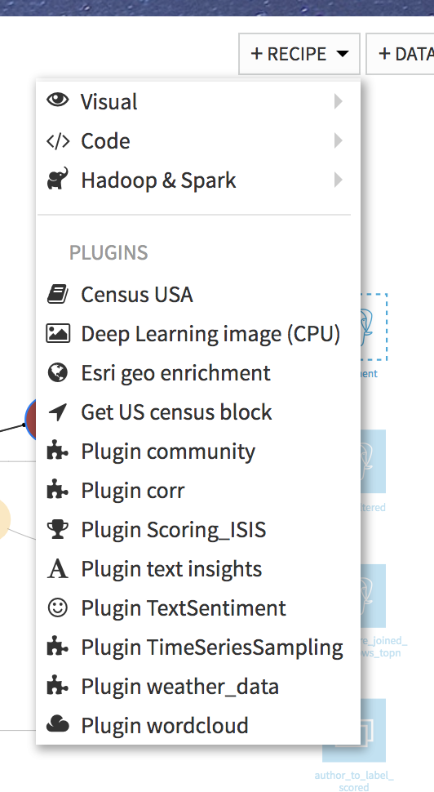
Plugins
Hands on`
TO DO:
Click +RECIPE and choose text insights
Use the sentiment analysis recipe to create a dataset Sentiment with this plugin
Split the latest Sentiment dataset into two datasets, according to the value of the sentiment. Exclude sentiment = 0
Sentiment_pos
Sentiment_neg

Slide 39
Static insights
A new concept
CONCEPT
Export data and charts created in code recipes and notebooks to dashboards ⇒ highly customizable
Static insights are updated each time you run the code
Plug in recipes can therefore output static insights !
Python
Plot.ly
Matplotlib
Bokeh
ggplot
R
ggplot2
dygraphs
ggvis
googleVis

Slide 40
Plugins
Hands on
TO DO:
On top of the Sentiment_pos and Sentiment_neg datasets:
Use the plug in text insights to create a recipe wordcloud with the columns tweet text Name the folders Wordcloud_pos et Wordcloud_neg This recipe outputs a folder that contains a wordcloud of a text column
⇒ Explore the newly created folders

Slide 41
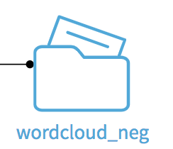
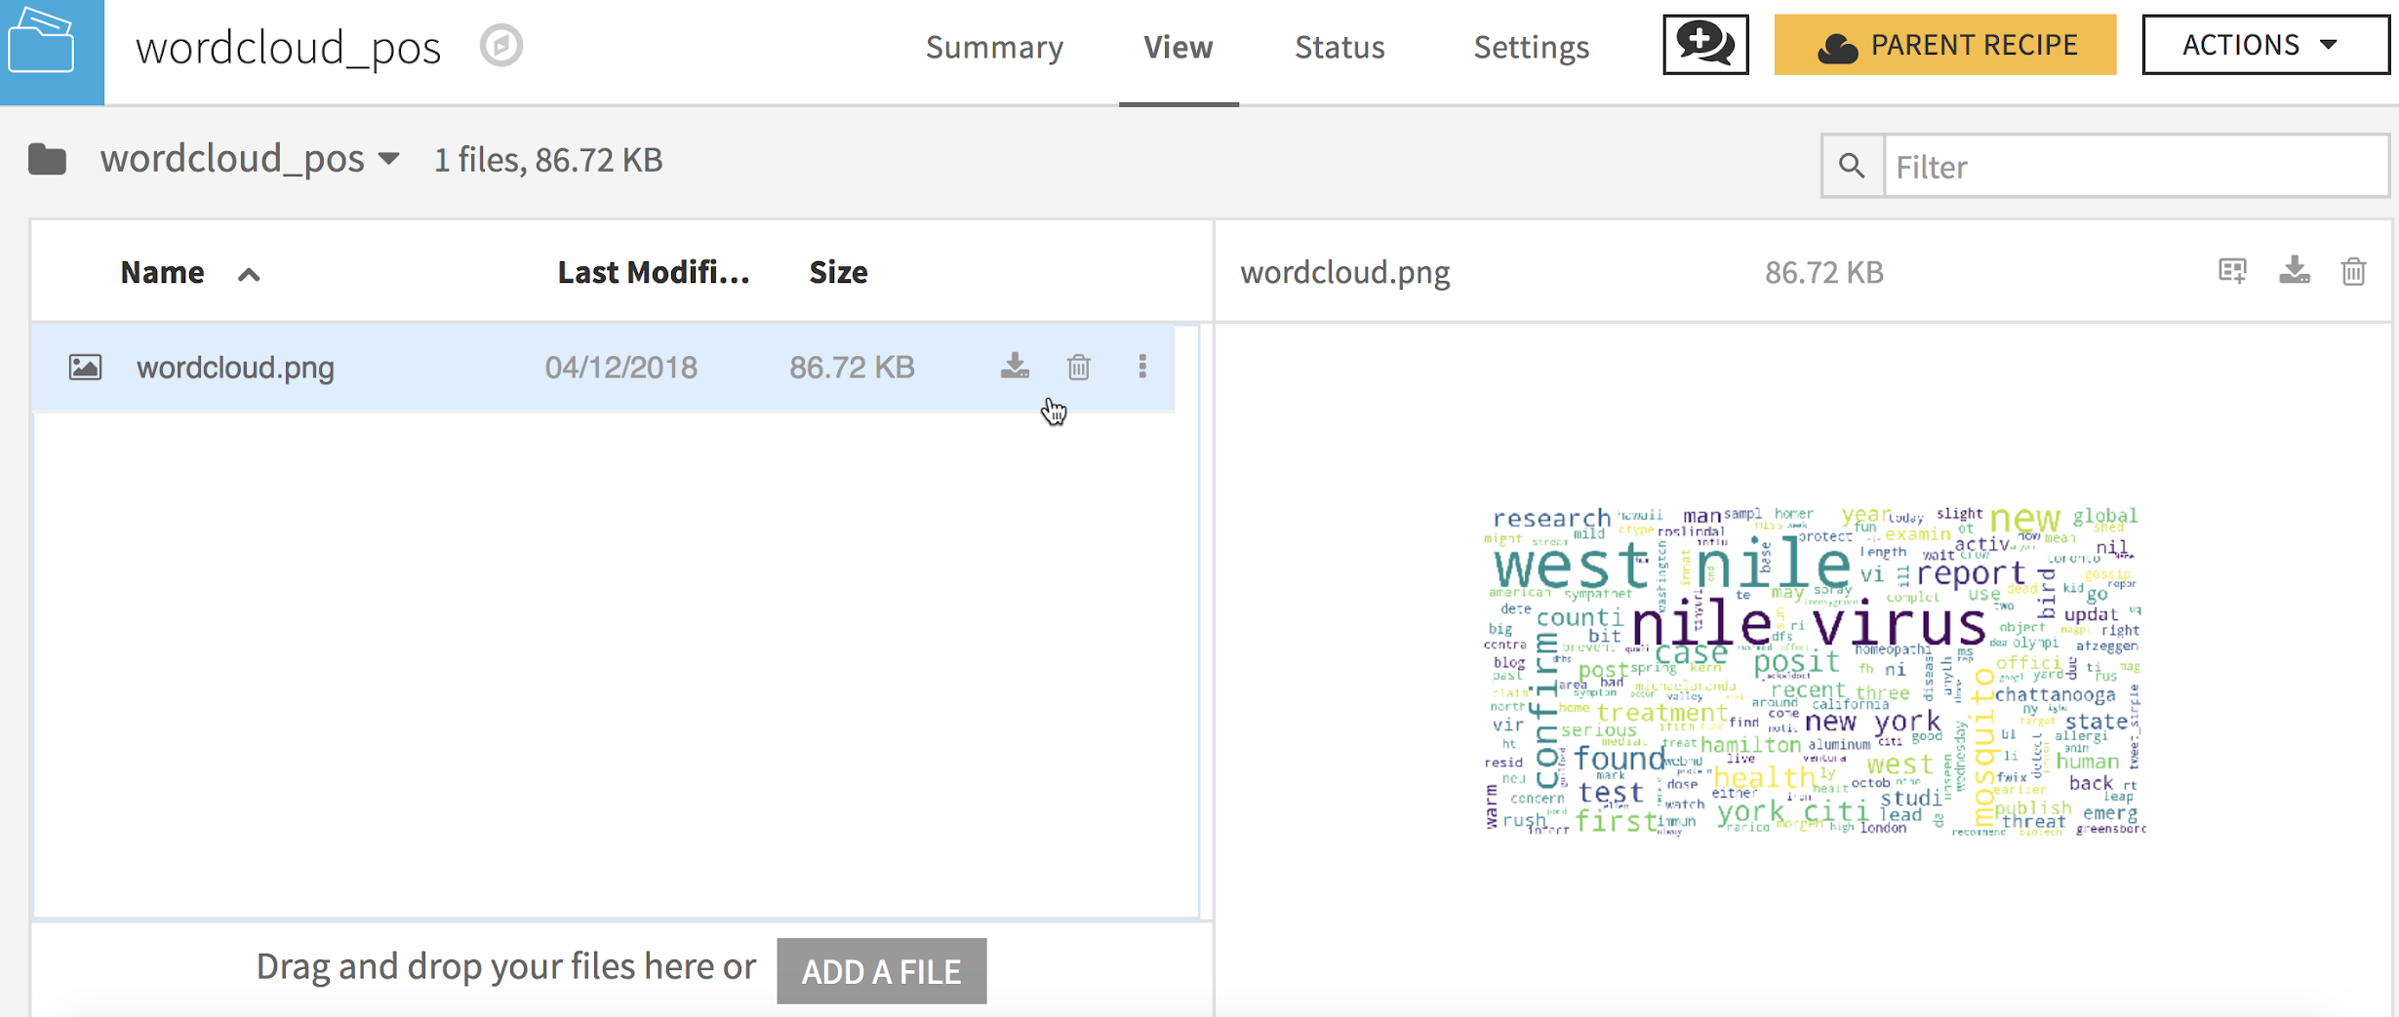
Plugins
Hands on
TO DO: This recipe outputs a folder that contains a wordcloud of a text column ⇒ Explore the newly created folders
More Folder Actions
Download file
Upload file

Slide 42
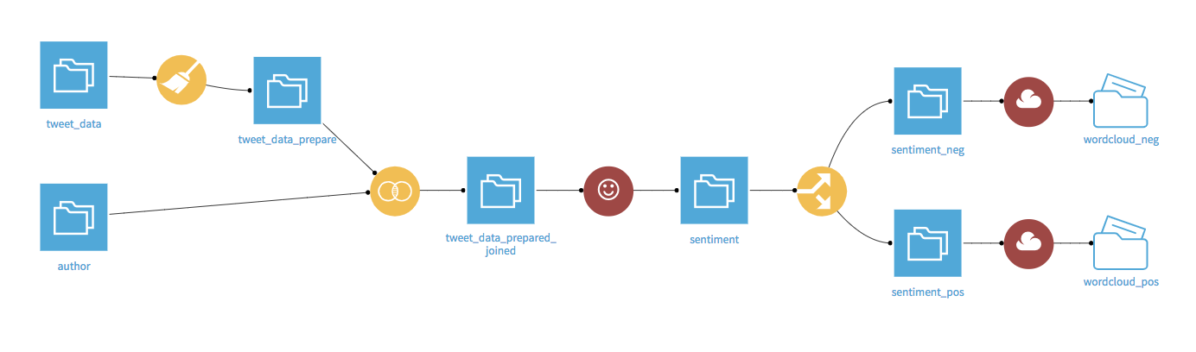
Plugins
Your flow should now be like this

Slide 43
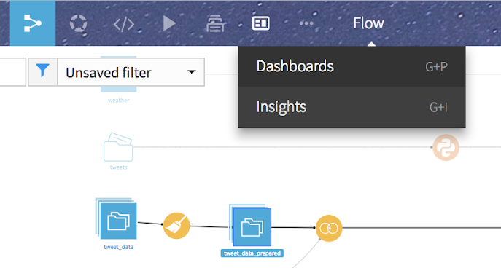
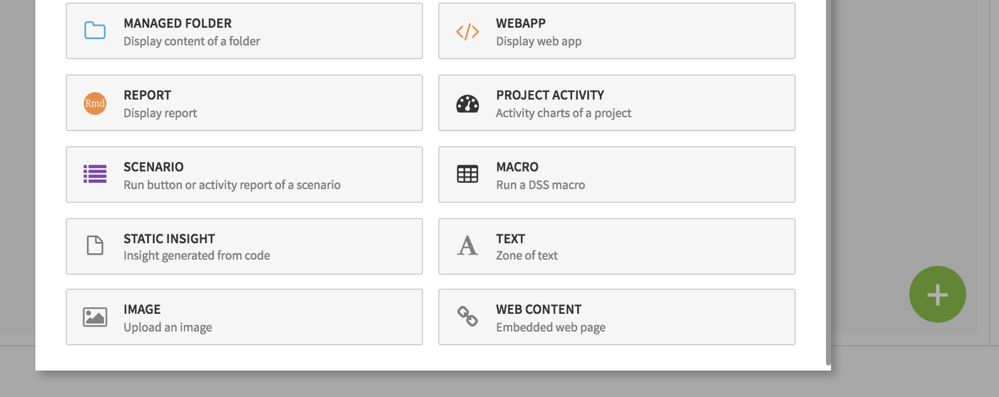
Static insights
Static insights are accessible via the flow
TO DO: Add the static insight created by the world cloud plug in to your dashboard
1
2

Slide 44
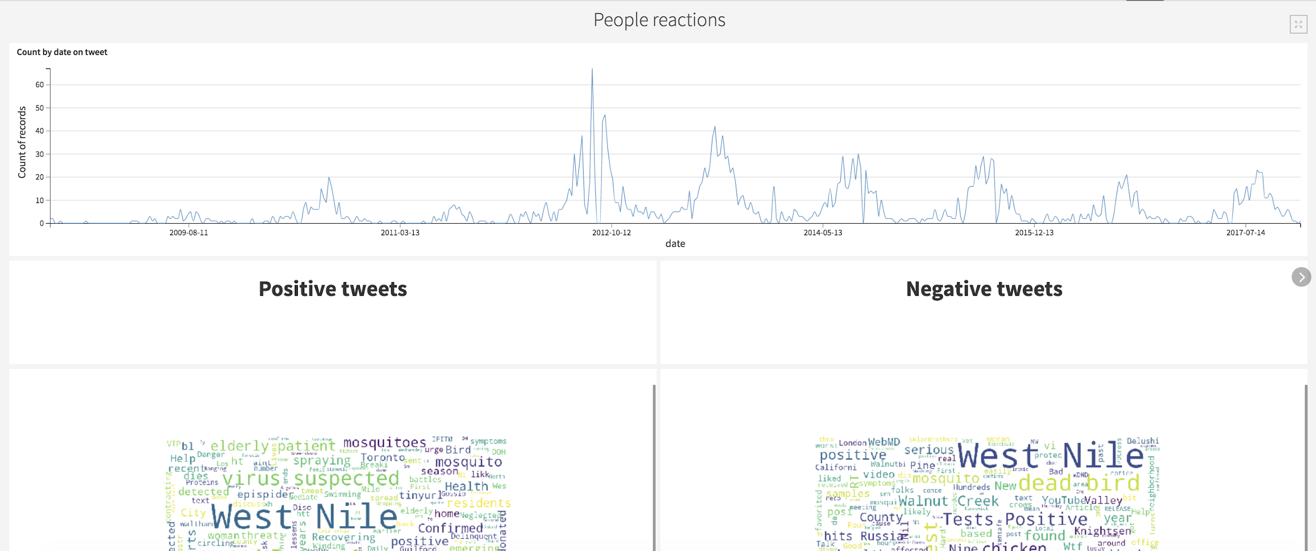
Static insights
Hands on
Your dashboard should be like this
⇒ Check the box “Use slide title as header on slide”

Slide 45
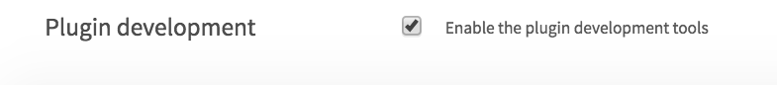
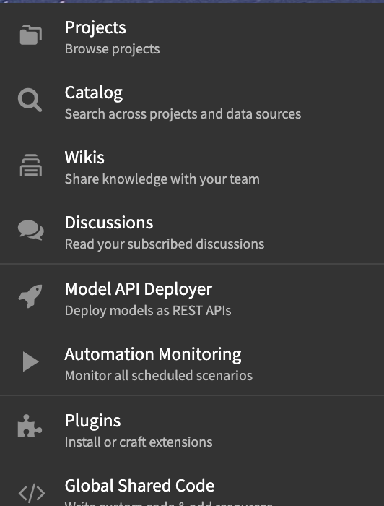
Plugins
Hands on
Only for your general knowledge!
TO DO: Look at the code of a plug in
Go to administration → settings → Misc. and check the box “Enable the plugin development tools”
Go to administration → plugin and move to development environment the Python and/or R plugin(s)
From the menu, go to Plugins → development

Slide 46
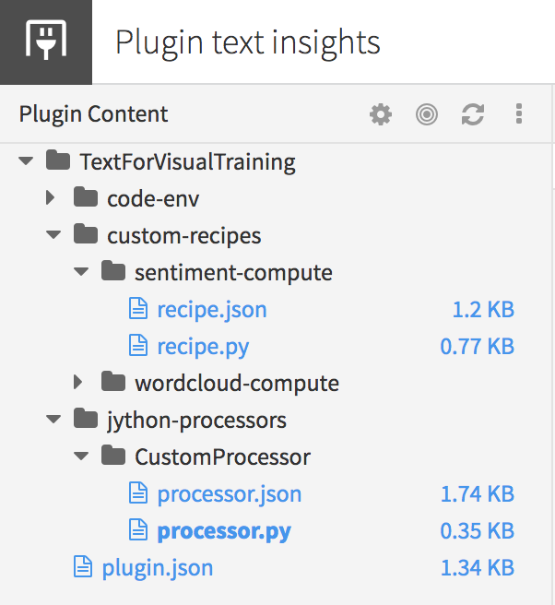
Plugins
Hands on
Only for your general knowledge!
TO DO: Look at the code of a plug in
Have a look at the code of a recipe ⇒ Plugin can be easily created by any Python coder
Parameters of the plugin
Code of the recipe

Slide 47
Plugins
Hands on
QUIZZ
Folders acts as regular file system folders. ⇒ What can they contain ?
Static insight are created when running a code recipe. ⇒ Do they need to be in a folder ?
Notes:
anything useful for your project such as
images, videos, .pptx, machine learning and deep learning models, …
2. No. If recipe outputs a dataset, static insights can still be created. Outputing in a folder is a way to do the recipe is not intended to output a dataset

Slide 48

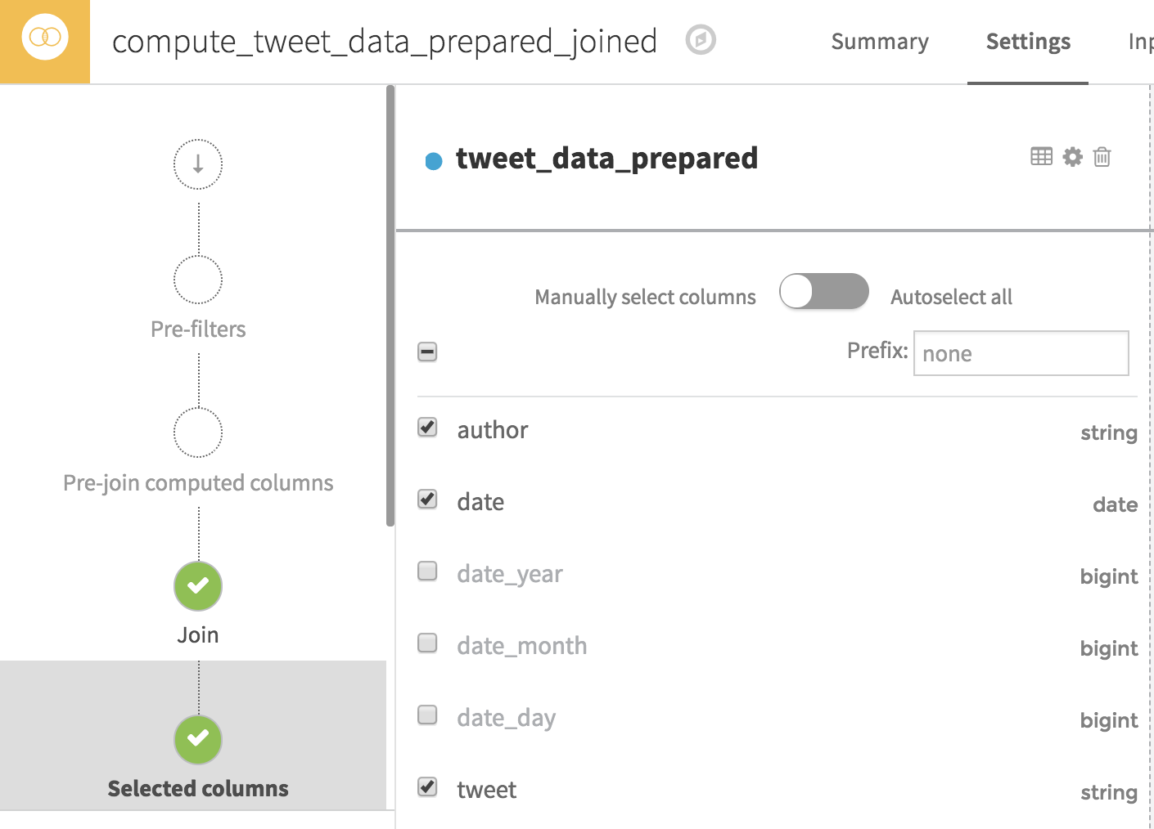
Schema propagation
The new columns appear in the next recipe if you enter the recipe
TO DO
Enter the join recipe
The schema is now up to date
But you must select the newly created columns

Slide 49
Plugins
Hands on
QUIZZ
Folders acts as regular file system folders. ⇒ What can they contain ?
Static insight are created when running a code recipe. ⇒ Do they need to be in a folder ?
Anything useful for your project such as images, videos, .pptx, machine learning and deep learning models, …
No. If a recipe outputs a dataset, static insights can still be created. Outputting in a folder is a way to proceed if the recipe is not intended to output a dataset

Slide 50
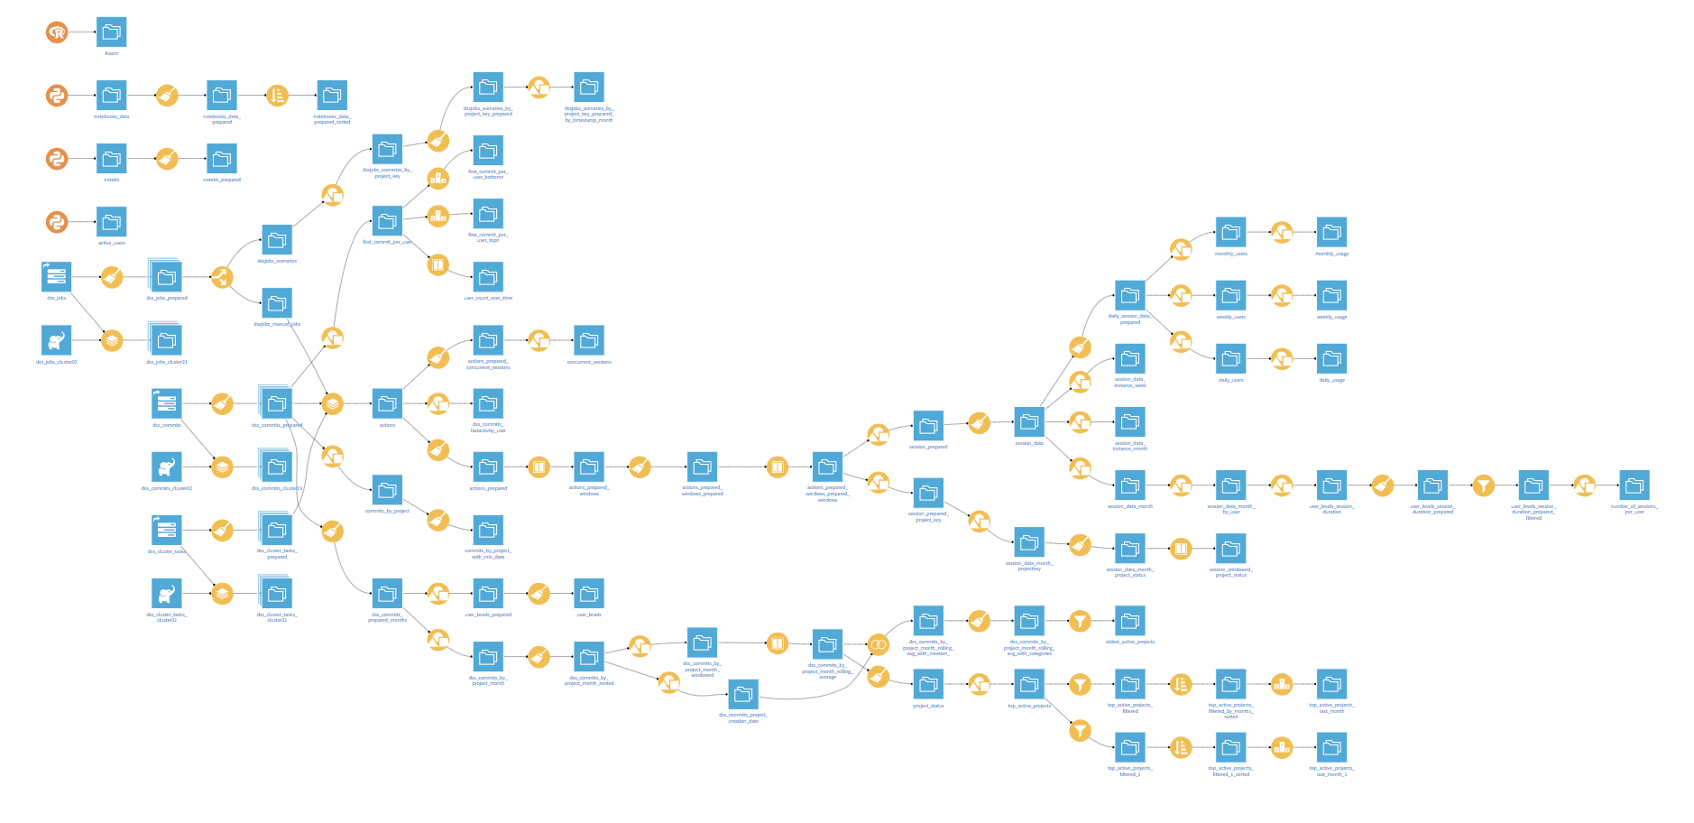
Flow views and actions
WHAT’S NEXT ?
Our flow now contains several elements
what if I want to check the execution engines, latest built, file formats, connections, … ?
what if I want to do massive changes ?
add new columns with the prepare recipe ?
change the connections from csv to HDFS ?
it is easy to get lost if you didn’t do the project yourself
better add descriptions, tags
In the next slides we
Explore some actions and views at a flow level
Customize our projects
Notes:
Start of coding track

